Slide 1

2.2 Defining Classes Part 1
academy.zariba.com

Slide 2
Lecture Content
What are Classes?
Access Modifiers
Fields
Properties
Constructors
Methods
Best Practices

Slide 3
1. What are Classes
Classes model real-world objects
They have a set of attributes (state, properties fields) and behavior (methods, operations)
Classes describe the structure of objects
Objects are the particular instances of a class

Slide 4
1. What are Classes
Classes in C# can have members
Fields, constants, methods, properties, indexers, events, operators, constructors, destructors,…
Inner types (inner classes, structures, enumerations, interfaces, delegates,…)
Members can have access modifiers (scope) – public, private, protected, internal, protected internal
Members can be static or specific for a given object.

Slide 5
2. Access modifiers
There are 5 types of access modifiers
private – only visible inside the class
protected – visible to the current class and its children classes (derived classes)
internal – visible inside the current project (assembly)
public – visible by everyone

Slide 6
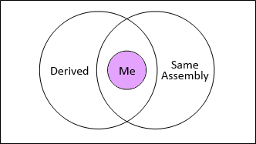
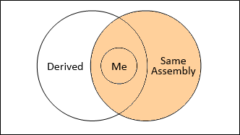
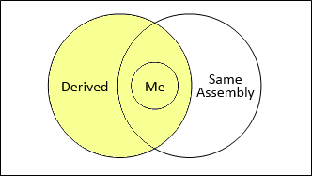
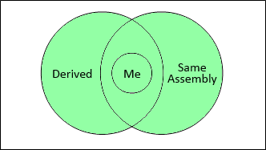
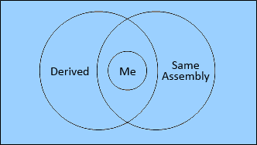
2. Access modifiers
private
internal
protected
protected internal
public

Slide 7




3. Fields
Bunnies
Zombies

Slide 8
4. Properties
Bunnies
Zombies

Slide 9
5. Constructors
Bunnies
Zombies

Slide 10
6. Methods
Bunnies
Zombies

Slide 11
7. Best Practices
Constructors and properties should keep the object’s state correct
This is known as encapsulation in OOP
Can force validation when creating/modifying the object’s internal state
Constructors define which properties are mandatory and which are optional
Property setters should validate the new value before saving it in the object field
Invalid values should cause an exception

Slide 12
Homework
Create your own simple Console Game
Define a class Hero that holds information about your character: name, health, level, mana, strength, agility, intelligence, primaryAttribute (as an enumeration, one of the previous 3), isBlocking, isDead, class (Sorcerer, Fighter, Tank), Weapon (class) and Armor(class).
Define a class Weapon which holds the following information: type (enumeration – Sword, Hammer, Staff, etc. ), class (common, rare, mythical), damage.
Define a class Armor which holds the following information: damageBlock, type (cask, shield etc), class (same as above).
Define several constructors for each class. Validate some of the properties. Use constants where necessary – don’t leave magical numbers in the code.
Define methods for each hero: Attack(Hero heroToAttack), TakeDamage(int damage), Block(). Attack should be clear. TakeDamage should reduce the health of the Hero but take into consideration the Armor (damageBlock). Block should trigger the isBlocking member. Whenever isBlocking is active the damageBlock is doubled. If isBlocking is activated, the attack for the next turn is decreased by 30% (after that it is restored). Hint: You should think in which method to check this condition.

Slide 13
Homework
Each method should display an update in the console of the current action and all changes after that. E.g. Attack() should display a message “Hero1 attacking Hero2. Hero2 has taken 30 damage …”. Hint: You can override the ToString() method to help you with the current state.
Test your application: Create 3 heroes, one from each class with the corresponding values, Armor and Weapon. Make a battle between them with repeated operations of attacking and blocking (in a while loop) and display who wins. To make it more interesting you can decide randomly which hero attacks, which hero is attacked and which hero blocks. Also, use Thread.Sleep() or UserInput between steps so that it is clear what is happening.
Note: Not all properties, fields and methods that you will need are listed here. It is up to you to design your game.

Slide 14

References

Slide 15



Zariba Academy
Questions

